Slide 1

DEPARTMENT OF CSE (ARTIFICIAL INTELLIGENCE AND MACHINE LEARNING) ACADEMIC YEAR 2025 - 2026 SEMESTER III ARTIFICIAL INTELLIGENCE LABORATORY MINI PROJECT REVIEW <Eye Detection Using Python>
REGISTER NUMBER | 2117240030120
NAME | SACHIN KUMAR K
YEAR | 2
SECTION | C
FACULTY IN-CHARGE | MRS BHAVANI M

Slide 2
PROBLEM STATEMENT
Detecting human eyes in digital images and videos is a fundamental step in computer vision applications such as facial recognition, drowsiness detection, and human–computer interaction.
This project aims to build a real-time eye detection system using OpenCV and Haar Cascade classifiers.
The system captures live video through a webcam, identifies faces, and then locates eyes within those faces.
Expected Result: Accurate detection of eyes in real-time video feed, visualized through bounding rectangles around detected eye regions.

Slide 3
THEORETICAL BACKGROUND
Computer Vision (CV) is a field of Artificial Intelligence that enables computers to interpret and understand visual information from the world. Eye detection is a subset of object detection, where specific regions (eyes) are located within a face. This project uses Haar Cascade Classifiers, a machine learning–based approach introduced by Paul Viola and Michael Jones, which trains on thousands of positive and negative images to recognize visual patterns.
Why Haar Cascade? It is fast, lightweight, and efficient for real-time applications — ideal for beginner-level AI vision projects.
Alternative Methods: Deep Learning models like CNNs (Convolutional Neural Networks) or pretrained DNN modules in OpenCV can also perform eye and face detection with higher accuracy, but they require more computational power.

Slide 4
IMPLEMENTATION AND CODE
Link to code in Git-hub Repository
List | Git-hub Repository Links
Implementation of Code Link | https://github.com/sachin17k/SACHIN-AI-LAB-MINI-PROJECT-.git
Word Document Report Link | https://1drv.ms/w/c/db1a87a07d0b3a15/EQgLGbm47kZNsDQclApqT2wB4_TzvknMy0VzZKZ2LP49uQ?e=NO02u6
PPT Link | https://1drv.ms/w/c/db1a87a07d0b3a15/EQgLGbm47kZNsDQclApqT2wB4_TzvknMy0VzZKZ2LP49uQ?e=Ocp3Zl

Slide 5
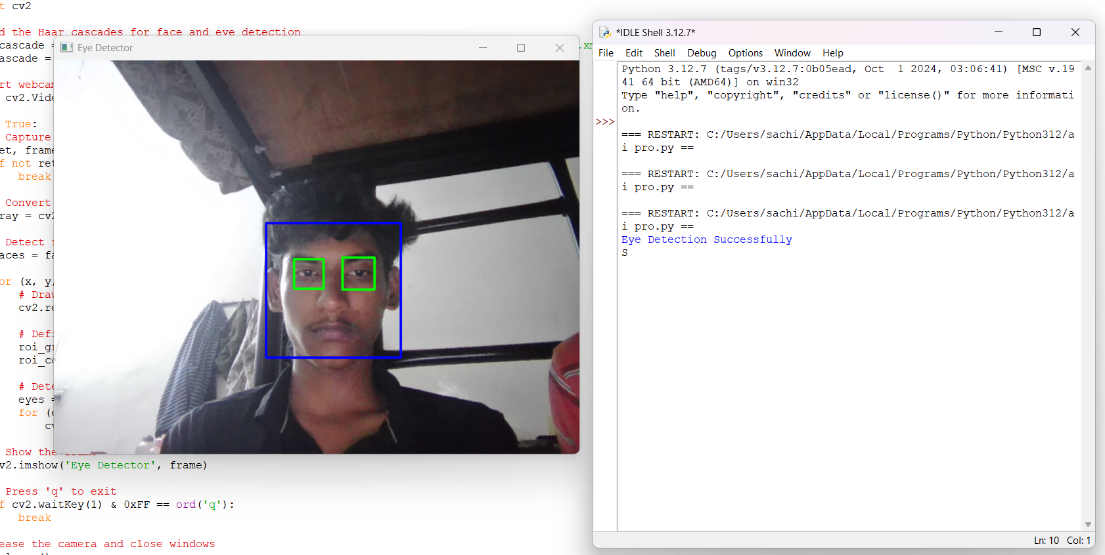
OUTPUT AND RESULTS

Slide 6
OUTPUT AND RESULTS
Detected eyes are highlighted with green rectangles on a live webcam feed.
The program successfully tracks eyes even under moderate lighting and movement.
Result: Eyes detected accurately for most frontal faces.
Future Enhancements:
Integrate blink detection for drowsiness monitoring.
Use DNN-based detectors for higher accuracy.
Extend to face and emotion recognition.

Slide 7
REFERENCES
Viola, P., & Jones, M. J. (2001). Rapid Object Detection using a Boosted Cascade of Simple Features.
OpenCV Documentation: https://docs.opencv.org
Python Official Documentation: https://python.org/doc
NumPy Documentation: https://numpy.org/doc
Adrian Rosebrock, “Eye Detection with OpenCV” – PyImageSearch Blog.

